Slide 1
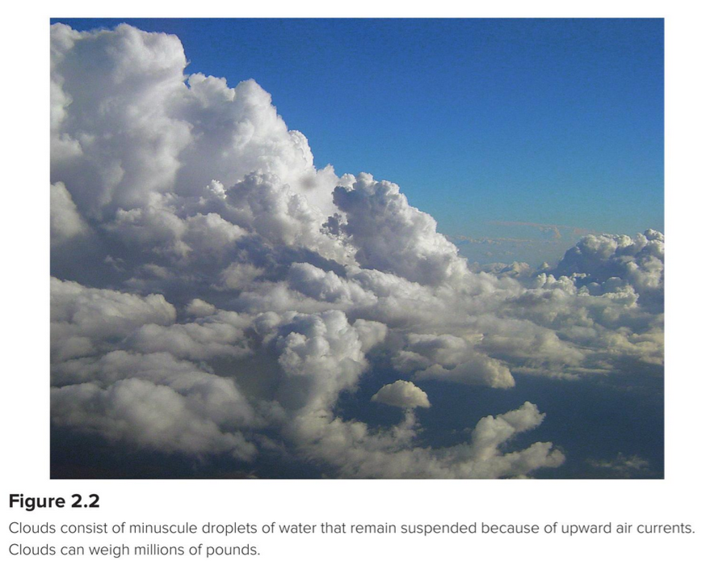
Back to the air … Here are the main gases … can you name them?

Slide 2
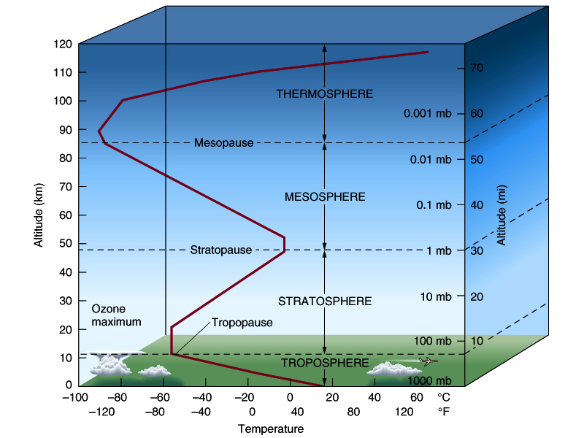
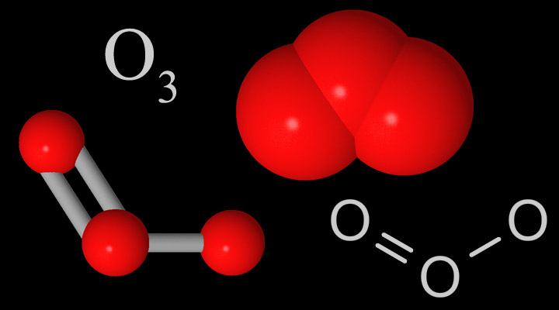
The stratosphere has more ozone (compared to in the troposphere)
N₂
O₂
H₂O (gas)
Ar
CH₄
CO₂
Other gases 1%

Slide 3
Recap: Ways of specifying gas concentration
Percent (%) can be thought of as parts per hundred.
Atmospheric O₂ concentration is 21%. If you grab a hundred air molecules, 21 will be O₂
Atmospheric N₂ concentration is 78%. If you grab a hundred air molecules, 78 will be N₂
Parts per million (ppm) is useful when the concentration is smaller than 1%.
Atmospheric CO₂ concentration is 419 ppm (as of January, 2022) … if you grab a million air molecules, 419 of them will be CO₂
Parts per billion (ppb) is useful when the concentration is even smaller.
N₂O concentration in preindustrial times was 270 … if you grabbed a billion air molecules, 270 of them would have been N₂O
Notes:
Concentrations of CO₂, CH₄, N₂O, and other anthropogenic greenhouse gases are on the rise, so you’ll find that values in the literature vary.
Concentrations of other pollutant gases vary a lot with location
ppm and ppb are sometimes written ppmv and ppbv

Slide 4
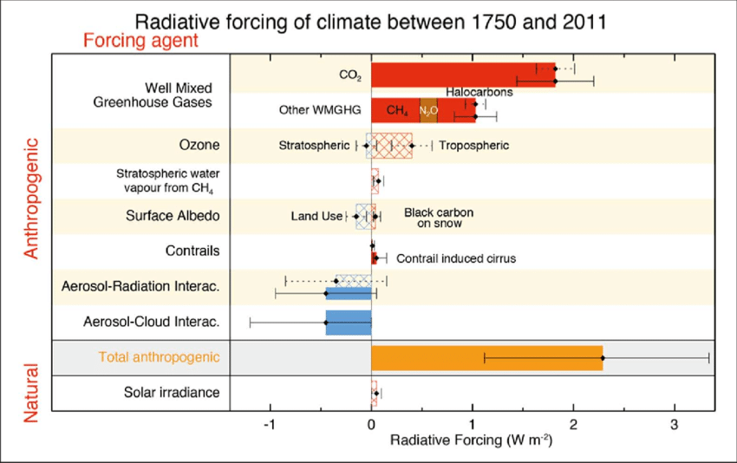
IPCC and radiative forcing
https://www.researchgate.net/profile/Franz_Mauelshagen/publication/263470663/figure/download/fig5/AS:654076018700289@1532955283491/Radiative-forcing-of-climate-bar-chart-showing-totals-for-1750-2011-RF-hatched-and.png

Slide 5
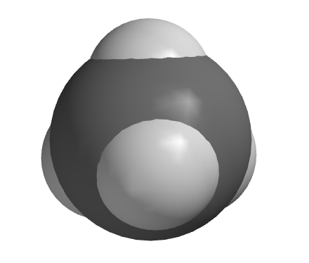
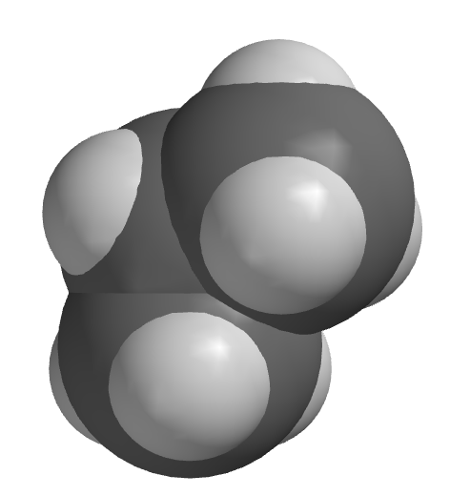
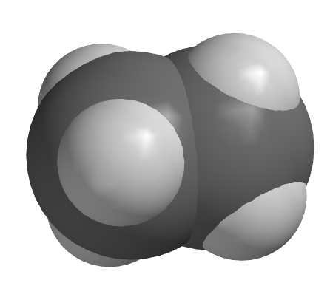
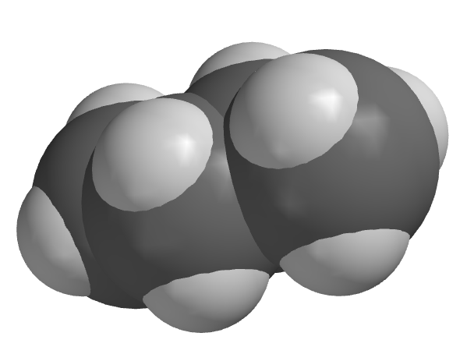
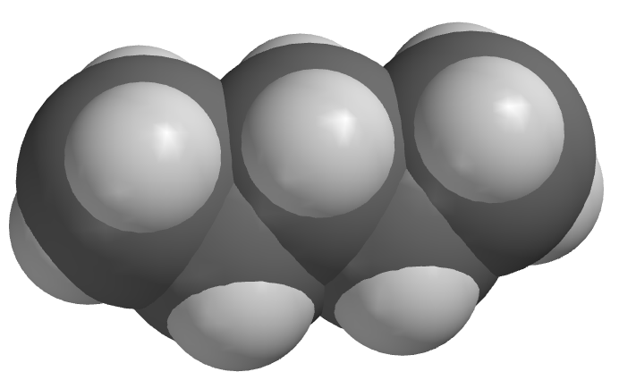
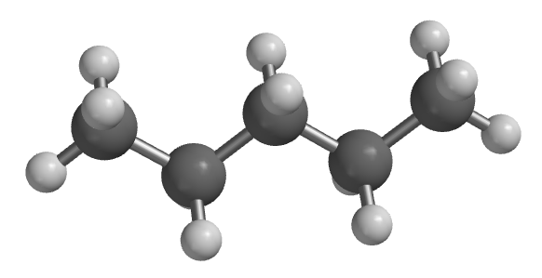
Hydrocarbons
ethane
methane
propane
pentane
butane
“Mother eats peanut butter”

Slide 6
Chemical equations
What’s the chemical equation?
2C + O₂ → 2CO
The “2” in front of C and CO are called stoichiometric coefficients
If there’s no number, it means the stoichiometric coefficient equals 1

Slide 7
When hydrocarbons burn …
ethane
ethane
2C₂H₆ +7O₂ → 4CO₂ + 6H₂O
4 of these
6 of these

Slide 8
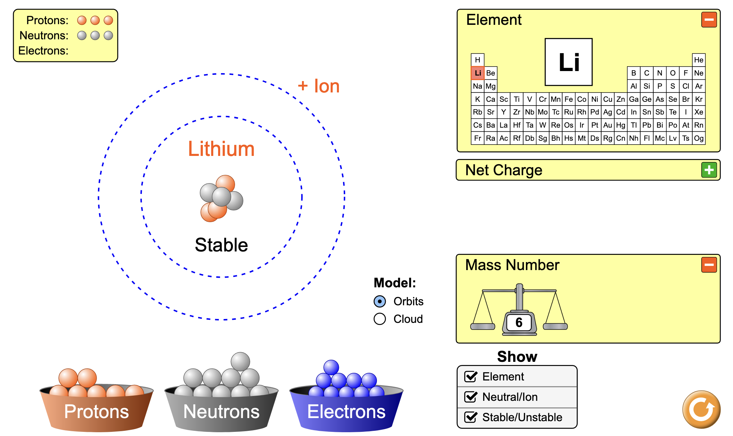
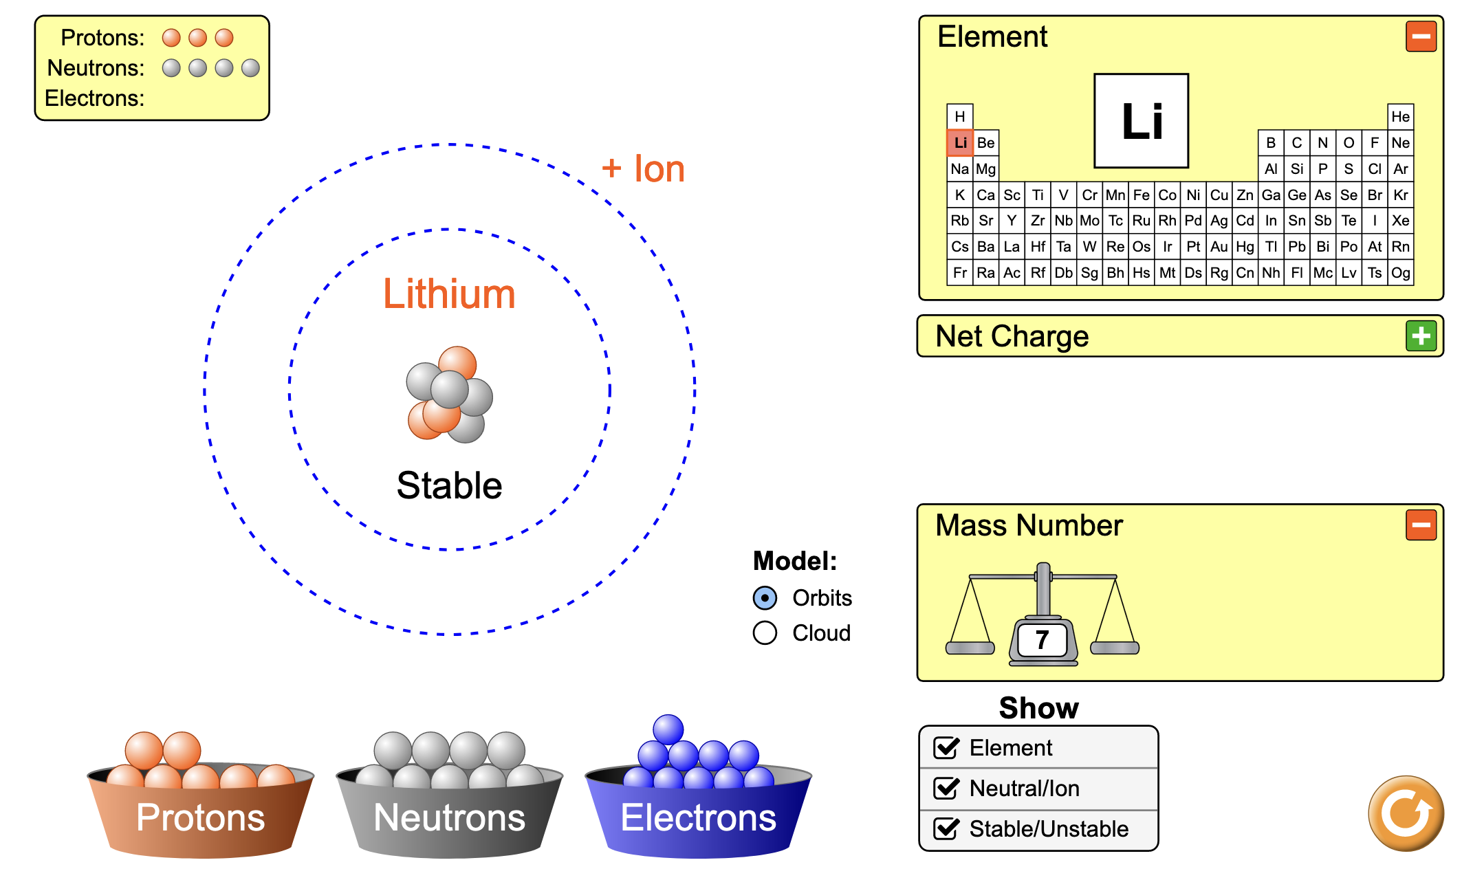
A shorthand for indicating isotopes
We said last week that the #neutrons + #protons is the mass number of an isotope.
Shorthand: ⁶Li and ⁷Li

Slide 9
Atomic Weights as an average of isotopes in the proportions found on Earth
So what’s that number below Li in the periodic table?
Answer: an average over the isotopes that occur on Earth!
We’ll call this value the Atomic Weight, symbolized by AW.
Based on the atomic weight, which do you suppose is more prevalent on Earth, ⁶Li or ⁷Li?
Observed abundances:
⁶Li – 8%
⁷Li – 92%

Slide 10
Molecular weights
AW = Atomic Weight (of an atom)
MW = Molecular Weight (of a molecule)
N has AW = 14.01, so
N₂ has MW = _______
C has AW = 12.01, and
H has 1.008, so
C₃H₈ has MW = _______

Slide 11
Molecular weights
AW = Atomic Weight (of an atom)
MW = Molecular Weight (of a molecule)
N has AW = 14.01, so
N₂ has MW = 28.02
C has AW = 12.01, and
H has 1.008, so
C₃H₈ has MW = 44.09

Slide 12
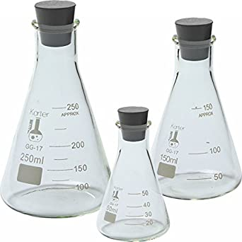
Three viewpoints chemists employ
What you can see & weigh in the lab
Chemical formulas
N₂(g) O₂(g) H₂O(g)
Molecular-level thinking (Spartan)
(Molecular)
Mathematical formulas
%, ppm conversions

